Slide 2
Applying best practices to Azure Kubernetes Service Cluster Management and High Availability
Mohammad Nofal
@mohmd_nofal
Cloud Native Compute Architect – Global Black Belt Team - EMEA
Notes:
Name
Role
Intro
Session Level
Understand the audience

Slide 3
This talk is a continuation for the operational best practices series we started last Ignite https://aka.ms/aks-operational-best-practices
Notes:
What was covered before

Slide 4
Agenda
High availability best practices
Cluster management best practices
Notes:
2 topics
The public repo

Slide 5
High Availability Best Practices

Slide 6
Kubernetes Architecture
Your Application
Internet
Kubernetes API
Kubernetes control
Worker node
kubelet
kube-proxy
Master node
Docker
Prod
Prod
API server
Containers
Containers
-controller-manager
-scheduler
Worker node
kubelet
kube-proxy
replication, namespace, serviceaccounts, etc.
etcd
Docker
Prod
Prod
Containers
Containers

Slide 7
AKS Availability (Control Plane/Masters)
AKS offers 99,5 SLO
What happens if masters are down?
API is down, no new management operations (scale, deploy, etc…), but applications are not impacted
How to improve?
Planned premium SKU in before the end of 2019
Multiple Clusters (less popular)
Notes:
Think of each component separately

Slide 8
AKS Availability (Kubernetes Nodes)
AKS follows the Azure VM availability SLA
2+ Nodes Cluster in VMAS or VMSS(now default) 99,95
Cluster in Mutli-AZ 99,99
How to achieve better availability?
Notes:
There is room for improvement

Slide 9
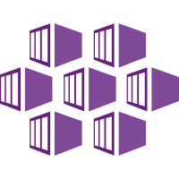
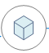



Our Application
Region 1
app namespace
Client App
Standard
Loadbalancer
region1-acr
Backend App
Mysql Database
Notes:
Intro to the applicatoin

Slide 10
Availability Considerations
The cluster
The state
The surrounding services (SLB or ALB, etc…)
The registry
The sessions
The region
All other components that make up your application
Notes:
The considerations

Slide 11
Cluster Nodes Availability Options
Highest RTO and RPO
Back up and Restore
Availability Zones
Multiple Clusters In Region
Multiple Clusters Across Regions
Lowest Cost and Complexity
Lowest RTO and RPO
Highest Cost and Complexity
RTO&RPO
Cost & Complexity
Notes:
The higher the availability the higher the cost and complexity

Slide 12
Backup and Restore
Goal: Restore cluster in case of failure
Stateless Cluster: Hooray! just re-deploy
Stateful Cluster: Redeploy and restore state
Both scenarios require you to have the cluster deployment as code to make the re-deployment process faster
Both scenarios require you to have your application deployed as part of a pipeline
But what about the STATE?
Notes:
Everything as code is a must

Slide 13
Restore State
Application Files
Restore from pipeline
Restore from a backup solution
Application Data (Persistent Volumes – Azure Disks)
Azure Snapshot API
Not native to Kubernetes
Heptio/VMware Velero
Kubernetes native and its the recommended way to automate backups
Note
There is no native API which supports copying disks snapshots to another region, only a PowerShell module https://docs.microsoft.com/en-us/azure/virtual-machines/scripts/virtual-machines-windows-powershell-sample-copy-snapshot-to-storage-account
Notes:
- 2 states (App Files and Data)
Now we have improved RTO and RPO, but we need higher availability!
No Azure files
Cross region snapshot isn’t available
Demo: no fan of video but time!

Slide 14
Demo
Backup and Restore

Slide 15

First party Kubernetes backup solution survey!
Scan the QR code to fill the survey on mobile device

Slide 16
Availability Zones

Slide 17

General Availability
Availability Zones
Kubernetes cluster
Azure Standard Load Balancer
Zone 1
Create an AKS cluster with nodes distributed across Availability Zones
An AZ is a unique physical location within an Azure region
Provide a higher level of availability to your applications (99,99%)
Note that regular Azure Disks are tied to a Zone
Limited to regions that support Zones (10 regions now)
Requires Standard Load Balancer SKU (Basic SKU does not support Zones)
Zone 2
Notes:
Better availability
Disks
SLB
GA

Slide 18
Our Application – with AZs
Region 1
app namespace
AZ1
Node1
AZ2
Client App
Standard Loadbalancer
region1-acr
Node2
AZ3
Node3
Backend App
Mysql Database
Notes:
- How the application will look like

Slide 19
Demo
Deploy our Application Across Availability Zones
Notes:
Live demo

Slide 20
Multiple Clusters / Multiple Regions

Slide 21


Multiple Clusters - Same Region
Region 1
Cluster1
app namespace
Master
Azure Load Balancer
Backend App
region1-acr
Read Replica1
Client Browser
Cluster2
app namespace
Azure Load Balancer
Read Replica 2
Backend App
Notes:
Protection from human errors only
State externalized

Slide 22
Multiple Clusters - Cross Region – One Master - Hot
Azure Region1
app namespace
R1-ACR
Read/Write
Master
Standard Loadbalancer
Geo Replication
Active
Backend App
Read Replica1
Client Browser
Traffic Manager
Azure Region2
Active
app namespace
R2-ACR
Read
Standard Loadbalancer
Read Replica 2
Backend App
Notes:
ACID, relational data bases, only reads
ACR, geo-replication or deploy twice

Slide 23
Multiple Clusters - Cross Region – Cold/Scaled Down
Azure Region1
app namespace
R1-ACR
Read/Write
Master
Standard Loadbalancer
Geo Replication
Active
Backend App
Read Replica1
Client Browser
Traffic Manager
Azure Region2
Cold \ Scaled Down
Active
app namespace
R2-ACR
Read
Standard Loadbalancer
Read Replica 2
Backend App
Notes:
- Less cost, lower RTO

Slide 24

Multiple Clusters - Cross Region – Multiple Masters
Azure Region 1
app namespace
Multi—Master Cosmos
R1-ACR
Read/Write
Standard LoadBalancer
Active
Read/Write
Backend App
Azure Region 2
Client Browser
Traffic Manager
app namespace
Active
R2-ACR
Read/Write
Standard LoadBalancer
Read/Write
Backend App
Notes:
- Active active, demo!

Slide 25
Demo
Multi-Region AKS Cluster

Slide 26
SLA and the 9’s of Availability
SLA | Down Time (Year) | Down Time (Month)
99,999% | 5.26 minutes | 25.9 seconds
99,99% | 52.56 minutes | 4.32 minutes
99,95% | 4.38 hours | 21.56 minutes
99,9% | 8.76 hours | 43.2 minutes
Notes:
Explain the significance of the 9s
Be conscious of the effort vs the benefit

Slide 27
Availability Recommendations
 | 99,95 | 99,99 | > 99,99 | Gotchas
Regions with AZs | 1- Deploy AKS Cluster in single zone 2- Back up and Restore Strategy | 1- Deploy AKS in multiple Azs 2- Backup and Restore Strategy | 99,99 + 1- Scaled down (Cold)cluster in another region 2- Hot Cluster (Active-Active) | 1- Cross AZ Charges 2- Affinity roles 3- the Data challenge
Region with No AZs | 1- Deploy AKS Cluster in single zone 2- Back up and Restore Strategy | 1- Backup and Restore Strategy 2- Scaled down (Cold)cluster in another region 3- Hot Cluster (Active-Active) | 1- Deploy AKS in multiple Azs 2- Backup and Restore Strategy 3- Scaled down (Cold)cluster in another region 4- Hot Cluster (Active-Active) | The data challenge
Notes:
Replaced in summary

Slide 28
Takeaways
Availability is a complex topic!
Everything as code and Backup Strategy is where you start and the most important
Backups should be shipped to different region(s)
Multi-AZ and Off-region Backups should be enough for most of your workloads
Watch out for the Cross-AZ Traffic Charges
If you don't have Azs and you need >99,95, then Multi-Region. challenge is always the STATE

Slide 29
Cluster Management

Slide 30
General Availability
Multiple node pools
Kubernetes cluster
Mix multiple VM types and configurations in the same cluster
Upgrade and scale each node pool independently
Notes:
- Different SKUs

Slide 31
NodePool considerations
AKS API operations will be decoupled for control plane and node pools.
Most operations are now at node pool level (scale, upgrade,…)
You can add taints to the node pool profile that will automatically add them to every new node
Cluster AutoScaler works on a per node pool basis
An AKS cluster can have a maximum of 8 node pools
An AKS cluster can have a maximum of 400 nodes across those node pools
You can leverage the Public IP per Node feature in selected node pools
Notes:
- Excited about the decoupling

Slide 32
General Availability
Standard Load Balancer
Kubernetes cluster
Azure Standard Load Balancer
One LB for Multiple Node Pools
All the new features from SLB:
TCP connections stay alive
HA Ports
Outbound rules
Faster (ops <30s)
TCP Reset on Idle
Support for Load Balancing across Zones
LB SLA of 99.99
Notes:
Budgeting 15 min. total

Slide 33
AKS Cluster Upgrades

Slide 34
Customer Responsibilities (Nodes)
Reboot nodes for operating system security patches
Kubernetes version upgrades
Operating system packages will be applied automatically with the new K8s version
Notes:
- Reboot and upgrades

Slide 35
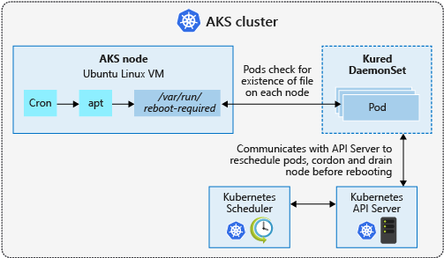
Process Node OS Security Patches
AKS automatically applies security patches to the nodes on a nightly schedule
You’re responsible to reboot as required
Regular maintenance recommended
Monthly ideal, 3 months maximum
Use Kured DaemonSet to watch for nodes requiring a reboot and handle the reschedule of the pods and reboot of the nodes. Check AKS documentation for guidance to use Kured

Slide 36
Kubernetes Versions
X.Y.Z i.e. 1.14.0
AKS Supports N-2 Latest Supported Version is 1.10.X
AKS supports 2 patch versions at any given minor release
1.14.0
Major No Current Plans for v 2.0.0
Minor Every ~ 3 month
New Features and APIs
Maintained for the 3 minor release branches
Minor release branch is maintained for ~9months
Patch Keeps Ticking / Week(s) Critical Bug Fixes to the Latest Minor Release
Notes:
https://github.com/kubernetes/community/blob/master/contributors/design-proposals/release/versioning.md#kubernetes-release-versioning

Slide 37
AKS - Kubernetes Version Upgrades
$ az aks upgrade --name myAKSCluster \
--resource-group myResourceGroup \
--kubernetes-version 1.15.4
Upgrades the API Server then the nodes
Done on node-by-node basis using the AKS upgrade API
Cordon and Drain the node and replace it by a new one
Drawbacks!
Takes time (especially when disks are involved)
Subject to failure
Notes:
- Originally

Slide 38
Blue/Green Upgrade – Node Pools
There is a new version available $ az aks get-upgrades -n k8s-ignite -g k8s "kubernetesVersion": "1.15.4”….
Upgrade the control plane $ az aks upgrade --control-plane-only -n k8s-ignite -g k8s –k 1.15.4
Add a new node pool with the new version $ az aks nodepool add -n new-node-pool --cluster-name k8s-ignite -g k8s –k 1.15.4 –c 3
Taint your new nodes $ kubectl taint nodes –l agentpool=new-node-pool nodepool=newNodePool:NoSchedule
Deploy a test version of your app and do your testing $ kubectl apply -f my-test-workload.yaml
All goes well, deploy a new version of your app with a new end point or Cordon-and-Drain the existing node pool or use Labels
Notes:
Demo here!

Slide 39
Blue/Green Upgrade - New Cluster
There is a new version available $ az aks get-upgrades -n k8s-ignite -g k8s "kubernetesVersion": "1.15.4”….
Create a new cluster $ az aks create -g k8s -n k8s-ignite-15.3 --kubernetes-version 1.15.4
Deploy a test version of your app and do your testing $ kubectl apply -f my-test-workload.yaml
All goes well, deploy a new version of your app with a new end point, then switch your DNS records
Notes:
High level
Mention the repo

Slide 40
Upgrade Strategies
 | AKS Upgrade API | Blue/Green (New Node Pool) | Blue/Green (New Cluster)
How | AKS Upgrade API | New Node Pool Taints and Tolerations | Automation + GLB (Traffic Manager)
Upgrade Duration | Depends on Cluster Size The Larger the cluster the longer the upgrade | Shortest | Short assuming full automation is in place
Risk | Subject to Failure | Safe - with the risk that the control plane upgrade will fail*** No impact on applications | Safest
When to use | Small Production Cluster Non-Mission Critical Workloads Non-Prod Environments | Large Clusters Mission Critical Workloads **assuming the Control Plane failure risk is accepted | Large Clusters Mission Critical Workloads
Notes:
Differeneces

Slide 41
Demo
Cluster Upgrade!

Slide 42
Tag Passthrough
MC_RG
My_Infra_RG
You can now pass tags to the AKS resource and these will Passthrough to the Infrastructure resource group (MC_)
Team: Dev1
CC: 123456
Custom Infrastructure Resource Group Naming
You can now pass a custom name to the Infrastructure RG (MC_)
Notes:
3 mnts for the whole thing

Slide 43
Create Cluster with Tags
$ az aks create \
--resource-group ignite-tags \
--node-resource-group ignite-tags-nodes-rg \
--name ignite-tags \
--tags project=ignite
$ az group show -n ignite-tags-nodes-rg -o json --query "tags"
{
"project": "ignite"
}

Slide 44
But we have a policy for tags?!!
Using Azure Policy
Enforce tags on resources groups (Deny Policy)
Apply tags on resources under the Infrastructure resource group (Append Policy)
Create a remediation policy for all-non compliant resources
Automate tag assignment for AKS infrastructure resources using Event Grid + Azure Functions or any other means

Slide 45
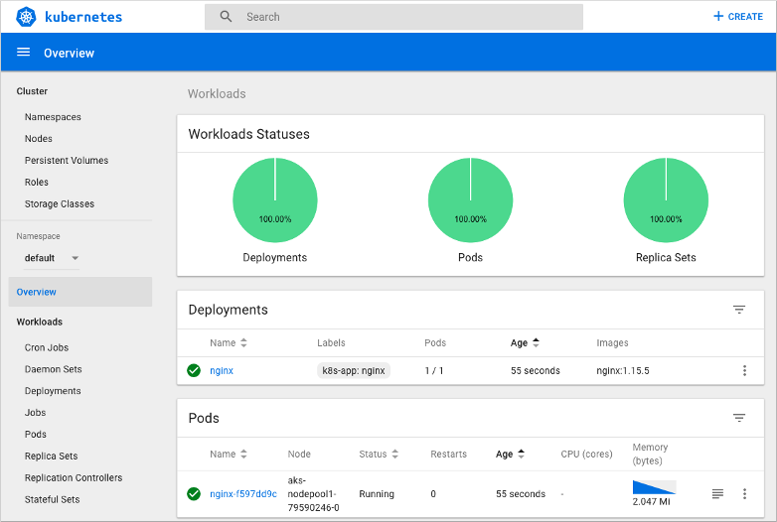
Kubernetes Dashboard

Slide 46
Disable the Dashboard (Recommended)
$ kubectl get pods -n kube-system | grep "dashboard"
kubernetes-dashboard-cc4cc9f58-whmhv 1/1 Running 0 30d
$ az aks disable-addons -a kube-dashboard -g k8s-demo -n k8s-demo-rbac
$ kubectl get pods -n kube-system | grep "dashboard"

Slide 47
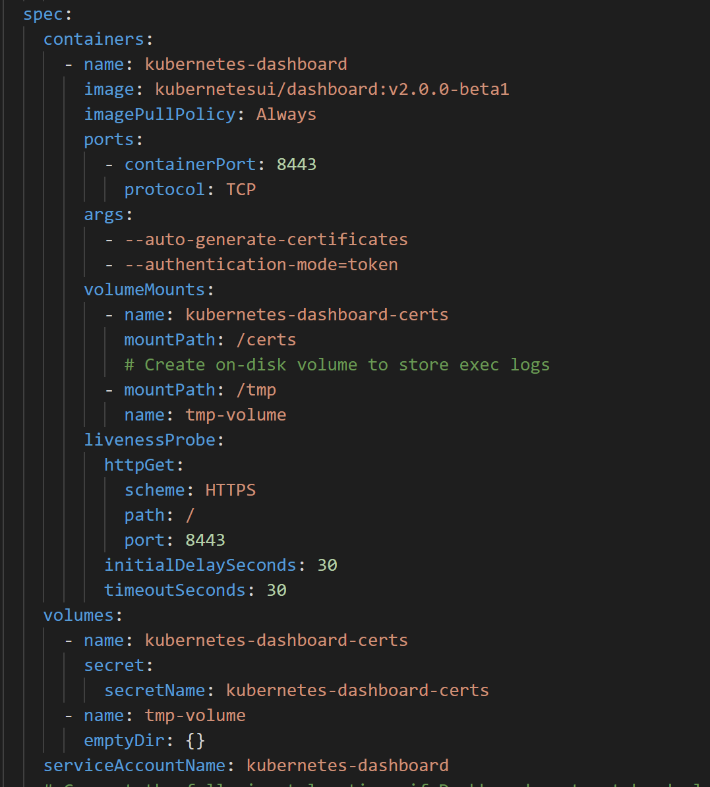
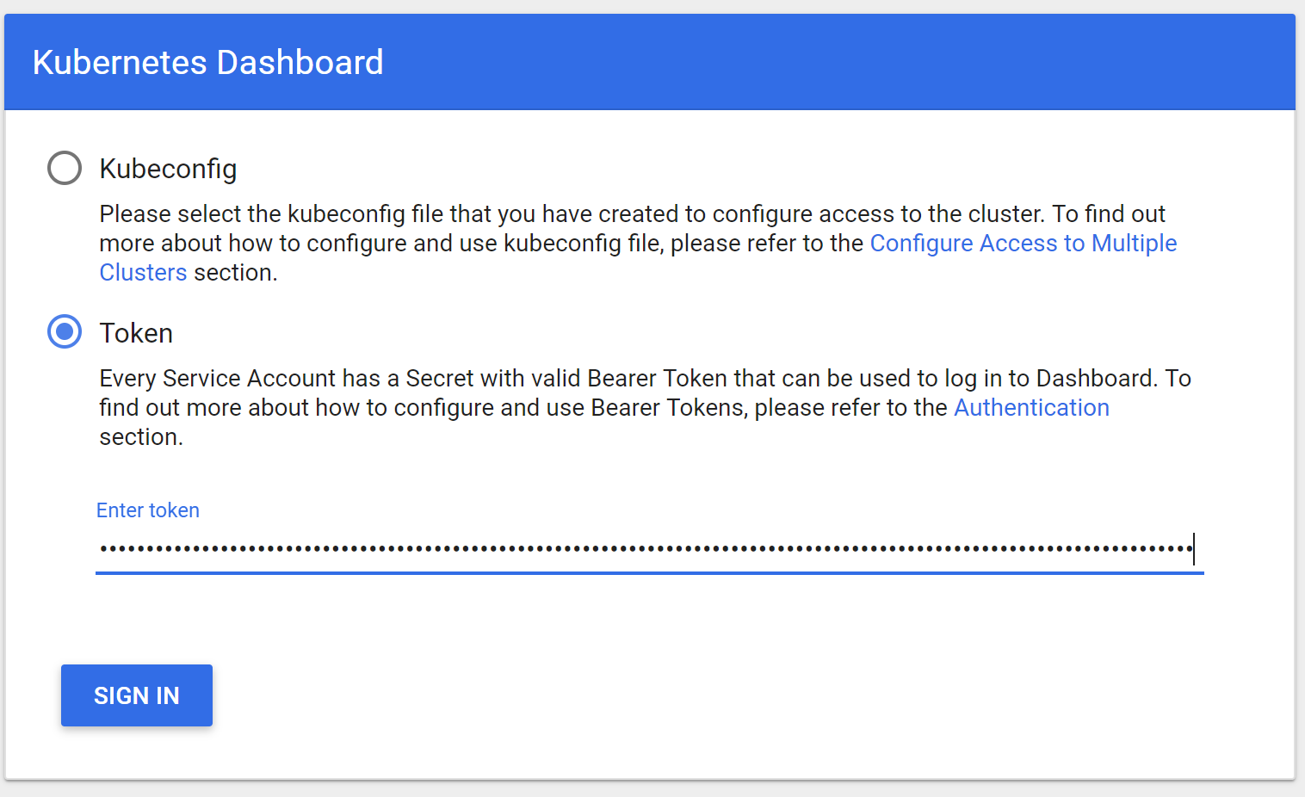
Kubernetes Dashboard – less worse

Slide 48





Node Management Through Azure Bastion
On-premises infrastructure
Azure Management VNET
Admin
Enterprise system
Azure Bastion Subnet
APP GW Subnet
Azure Bastion
Azure Express Route
Azure AKS VNet
VNet peering
Private IP
AKS subnet
Internal LB
AKS cluster
Ingress
contoso.com/A
contoso.com/B
service.contoso.com
ServiceA
ServiceB
ServiceC
Notes:
- Best practice is never to login to the machines and have proper monitoring and logging in place, the bastion is there for extreme cases

Slide 49
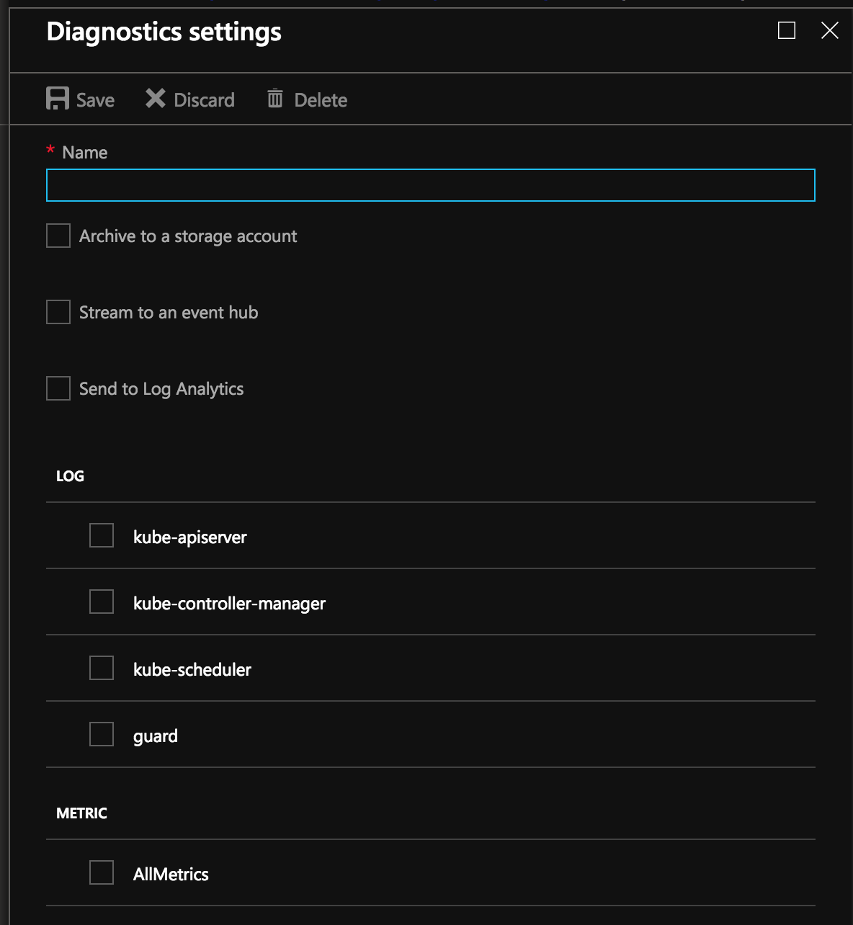
Enable Control plane logs
Use the Azure portal to enable diagnostics logs
Pipe logs to Log Analytics, Event Hub or a storage account
Metrics available today
kube-controller-manager
kube-api-server
kube-scheduler
Audit logs (new)
cluster-autosclaer

Slide 50
Takeaways
Use Standard Load Balancer
Use Nodepools!
Maintain N-1 for minor releases for production workloads
3 months upgrade cycle for minor versions is recommended
Always wait for the 2nd or 3rd patch version
Automate nodes reboot for security patches using Kured
Blue/green cluster upgrades for your mission critical workloads

Slide 51
Resources
This talk demos and transcript can be found here https://aka.ms/aks-ignite-demos
AKS best practices documentation https://docs.microsoft.com/en-us/azure/aks/best-practices
AKS documentation https://docs.microsoft.com/en-us/azure/aks/
Kubernetes docs https://kubernetes.io/
Notes:
Mention the repo

Slide 52
Thank you!
Notes:
Finish!

